Slide 1
Testing and Debugging part 1

Slide 2

Debugging...

Slide 3
Introduction
Testing and Debugging = locating and fixing errors
5 types:
opening and installation errors:
already visible during the opening of a project
compilation errors:
during programming
testing errors:
tests do not run
tests do not succeed
start-up errors:
when you want to run your programme, but it does not start
runtime errors: during the execution of your program:
your programme runs and crashes at the start or during execution
logical errors: the programme does not give the expected / logical result
Debugger
can help you detect runtime errors and logical errors
not for installation errors, compilation errors and start-up errors

Slide 4
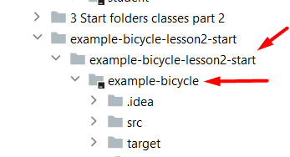
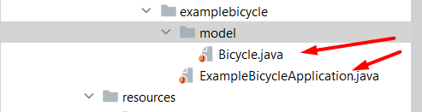

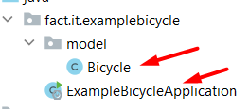

Opening error
Opening error appears when opening a project that is not a project:
Open IntelliJ
Choose File>Open...
Click on a project with the special icon:
If not clicked on
=>
in stead of..

Slide 5
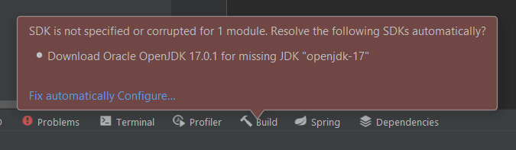
Installation error
Following problems may appear when the project you want to open has a different JDK-version than the one of your IntelliJ-installation:
In case you get the following error, follow the steps below and on the next slide:
Click on ‘Configure…’ and choose the JDK that you have installed on your laptop

Slide 6
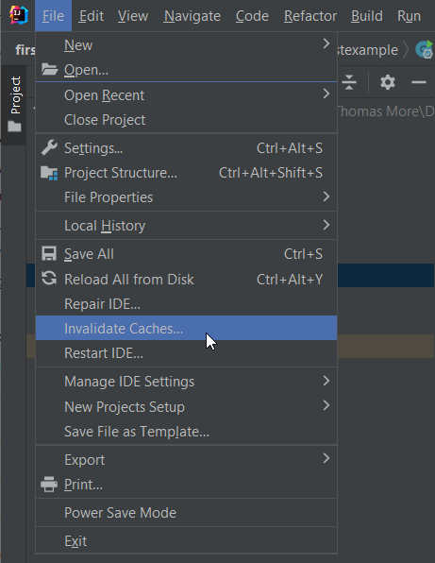
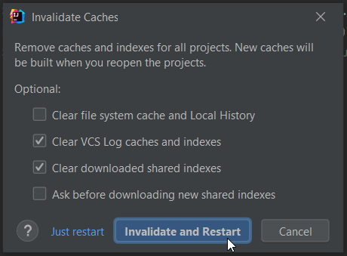
Installation error
When the problem is not solved, click on File > Invalidate Caches…, next click on ‘Invalidate and Restart’

Slide 7
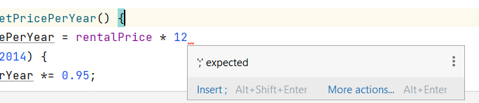
Compilation errors
Knowing WHAT is wrong is often half the solution:
READ the red text accompanying the error and try to understand it.
Do not blindly carry out the solutions suggested by IntelliJ. This often causes more problems…
Some common examples:
Solution: add a “;” at the end of the line…

Slide 8
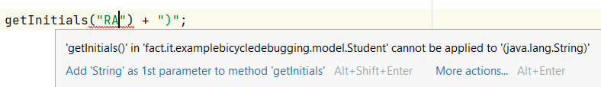
Compilation errors
Some common examples:
the method “getInitials()” does not have a parameter. 2 possible solutions:
=> delete the parameter “RA” between the brackets
=> change the method definition in the class so a parameter of the type String is required
Check the exercise to know what you have to do…

Slide 9
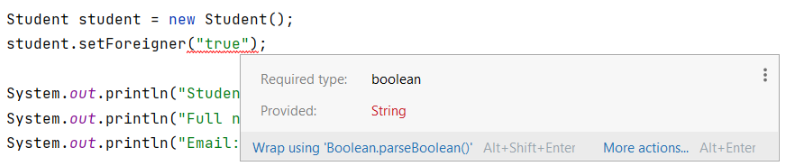
Compilation errors
Some common examples:
the method requires a boolean but provides a String (“true”). Solution:
setForeigner(true)

Slide 10
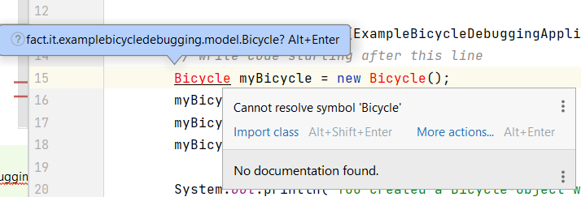
Compilation errors
Some common examples:
the class “Bicycle” is not imported in the application Solution:
press Alt+Enter and the class will be imported by IntelliJ

Slide 11
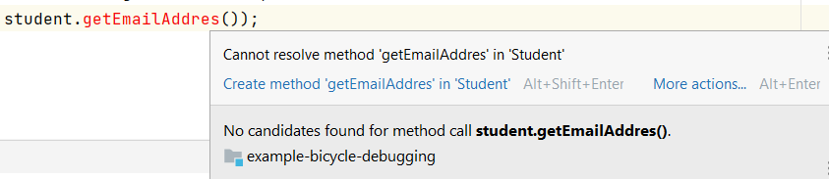
Compilation errors
Some common examples:
the method “getEmailAddres()” does not exist. 2 possible solutions:
=> check the name of the method. If it is the wrong name, correct it getEmailAddress()
=> create a new method with this name. You can let IntelliJ do this for you by pressing Alt+Shift+Enter BUT be careful! The compilation error will disappear but you possibly create errors later on…

Slide 12
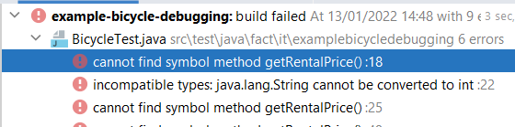
Test errors – tests do not run
If you haven’t programmed all methods OR a wrong method’s name is used somewhere in the program, the tests will not run.
E.g.
Check the names of the methods you had to program:
do you have programmed ALL required methods?
do they have exactly the same name as required?
has the method you programmed the exact signature (type and sequence of the method’s parameters) as required?
NEVER change code in a test-file!

Slide 13
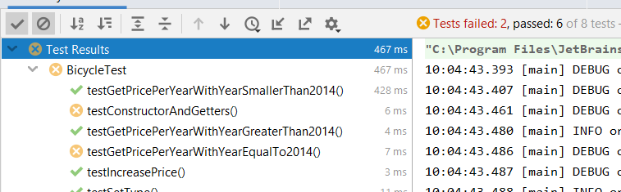
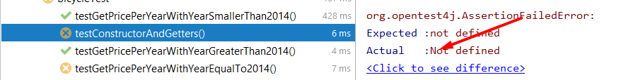

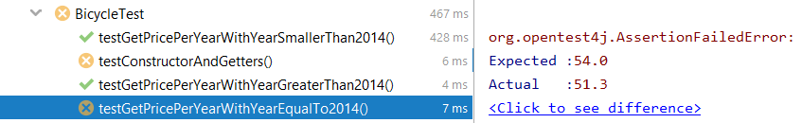

Test errors – tests do not succeed
If you coded all methods but you made a mistake in calculation or result:
Correct the mistake by looking at the difference between what “Expected” and “Actual”
NEVER change code in a test-file!

Slide 14
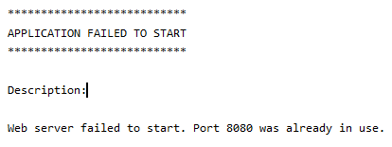



Starting error
Application failed to start when you run the application:
FIRST look at all open windows of IntelliJ. If one of these windows have a red icon at the top right: another web application is running. Click on the red square and try to run your application again…
If this does not work => Change the port that your application uses in the application.properties file:

Slide 15
Runtime errors
A common example => NullPointerException:
NullPointerException occurs when a method is called from an object that is "null" (i.e., not instantiated)
Solution:
Look/read which object = null and find the cause…
Make sure that the object is instantiated / gets a value… In this case “surname” is empty and needs to get a value.

Slide 16
Tips & tricks
Googling "blindly" and doing what is suggested often causes more errors than before
Only start "Googling" AFTER
you have read the error carefully and do not find the solution on that basis
you have not found the solution on the basis of the above
"Smart" googling =
give context to the error:
IntelliJ
Java
Thymeleaf
MySQL
…
copy error message literally
links at the top
stackoverflow

Slide 17
Tips & tricks
consulting fellow students / social media / ...
compared to the previous steps
increased risk of errors
less/no learning effect: this source cannot/should not be consulted during evaluation moments => risk of being judged as “fraud”
official teaching channels (Canvas, Teams, Outlook Mail):
100% sure of correct information
learning effect is greater

Slide 18
Debugging with the IntelliJ Debugger
A detailed demo of how to use the IntelliJ debugger to debug your program can be seen in this video: https://www.youtube.com/watch?v=1bCgzjatcr4
In the next slides you find a summary of this content…

Slide 19
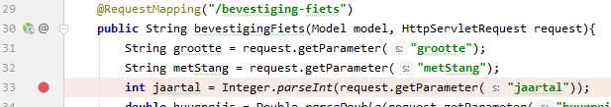

Debugging with the IntelliJ Debugger
When you use a debugger, you put red breakpoints in the program. A breakpoint is a place in the program where it will stop.
Then you can run the program in debug mode by clicking on the bug icon at the top.
With the controls at the bottom of the Debugger/Console window you can control the execution of your program yourself:

Slide 20

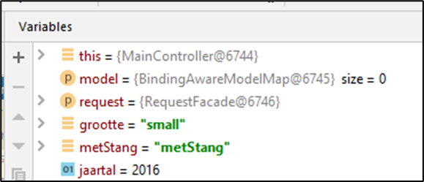
Debugging with the IntelliJ Debugger
The current contents of the variables are listed at the end as information, and can be accessed by hovering over a variable:
The contents of the variables can also be viewed in the variables tab at the bottom:

Slide 21
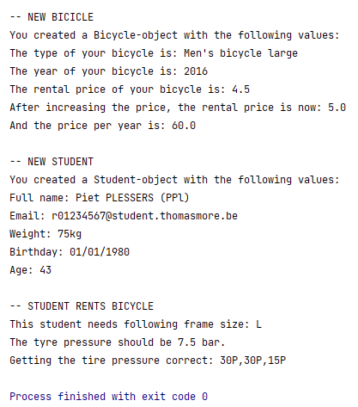
Exercise: Find the error …
On Canvas you can find
a zip-file “Debugging small exercises” which contains the solutions of the API-exercises but with “some” errors in. Don’t look at your own solution of these exercises but try to solve the errors in these applications
a zip-file: “Debugging large exercise” which contains 1 application with a lot of errors.
When all errors are solved and the application runs, the result should be:
And remember:
NEVER change code in a test-file!

